Slide 1
Cyclistic Case Study
Federico Bereziuk
December 2023

Slide 2
Introduction
Business task: Find ways to convince casual riders to buy annual memberships
Data Source: Byke rides database from July to October 2023
Stakeholder: Lili Moreno

Slide 3
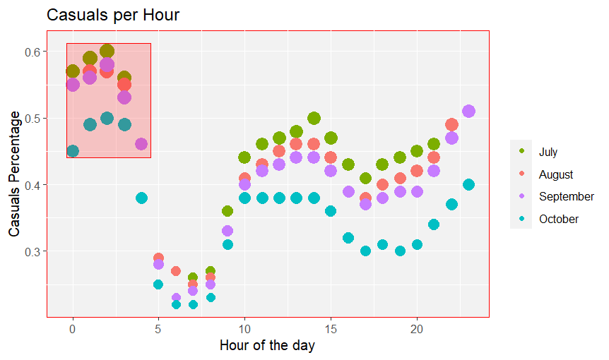
Findings
Casual usage per hour:
In the red square we can see that the higher percentage of casual riders occurs between 0 and 4 am

Slide 4
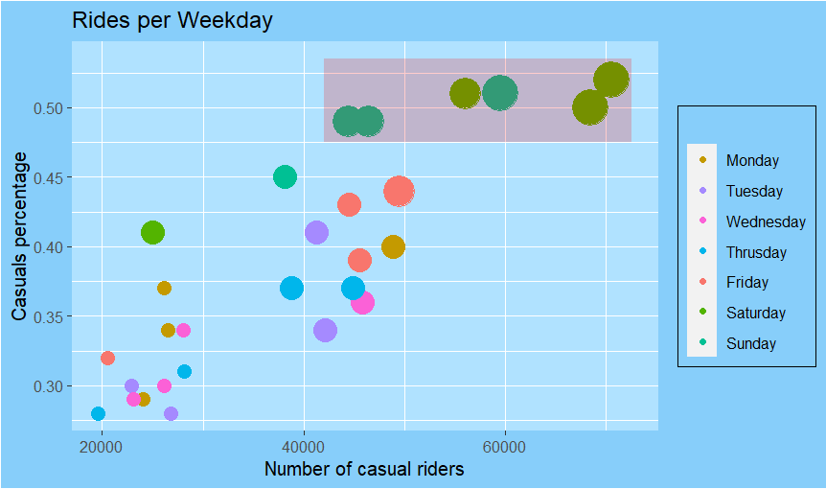
Findings 2
Casuals usage per Weekday:
We can observe a greater Casuals ratio on weekends

Slide 5
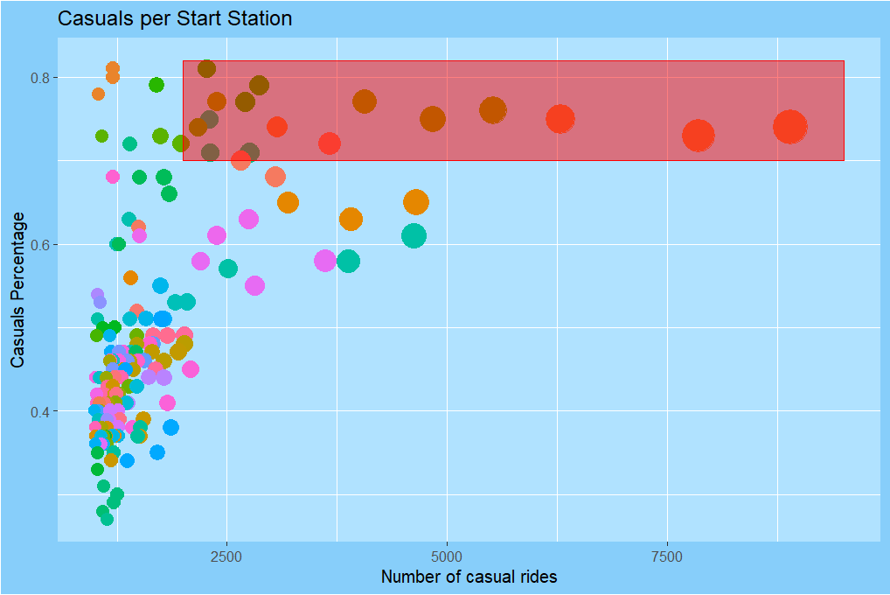
Findings 3
Casuals per Station:
We will focus on the red square area, where casuals percentage is greater than 70% and rides per month is greater than 2000

Slide 6
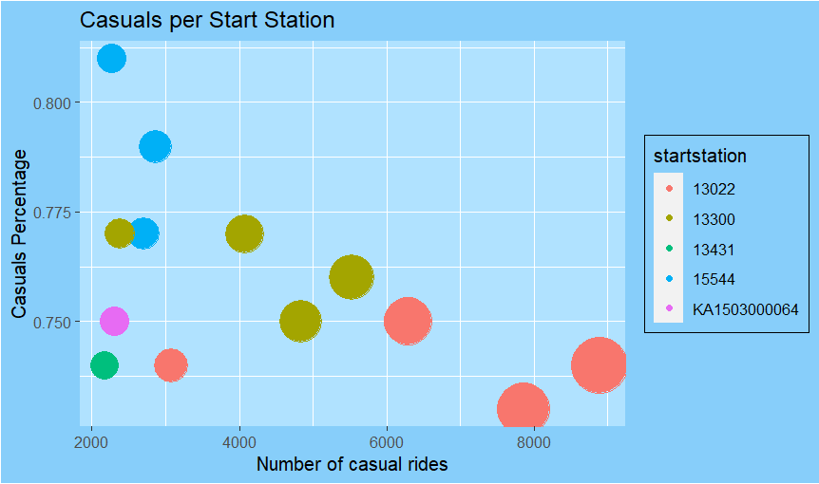
Findings 3
We can see that this six stations have the greater percentage and number for casual riders

Slide 7
Recommendations
We should promote specials memberships for high casual ratio segments
Like
Weekend Membership
Night Membership

Slide 8
Recommendations
We should develop a specific marketing strategy on site for the six stations with the higher casuals

